Slide 1
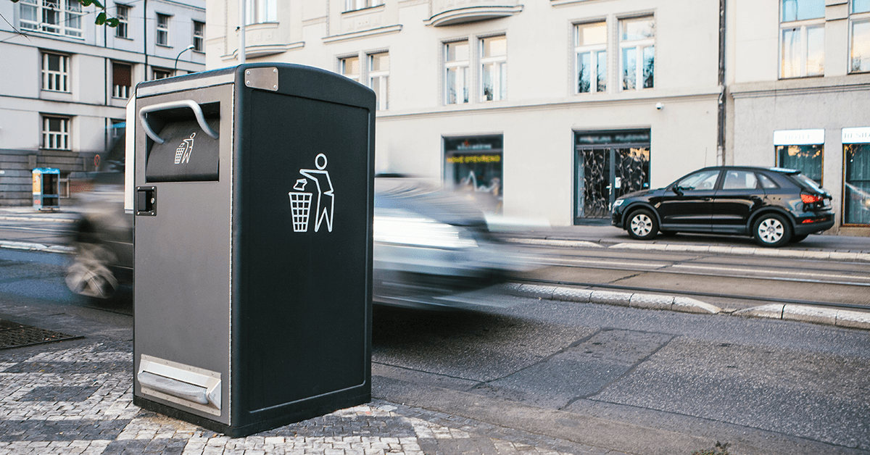
Stock-loss Prevention
- AI -
Team E
Borislav Pavlov, Young Oh Kim, Geo Ryang Park, Min Jae Kim
Capstone Design_SWE3028-41

Slide 2
Outline
Done
Implement New model : CNN, LSTM, LSTM-CNN fusion
CNN + Residual layer
LSTM-CNN is mixed at Fully-Connected layer
To be done
Improve performance
Data preprocessing
Predicting Data Height Re-Correction

Slide 3
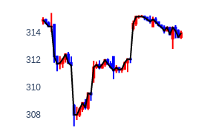
Dataset
Dataset Changed
Hour-by-hour Dataset
50 hours to predict 1 hour after
Need 2 inputs (CNN, LSTM)
<Input>
<Output>
[CNN]
Closed Price of 1 hour
(after 50 hours)
Candle stick Img
Shape : (N, 350, 350, 3)
50 hours
1hour
Closed price of 50 hours
Shape : (N, 50, 1)
Log scale
[LSTM]

Slide 4
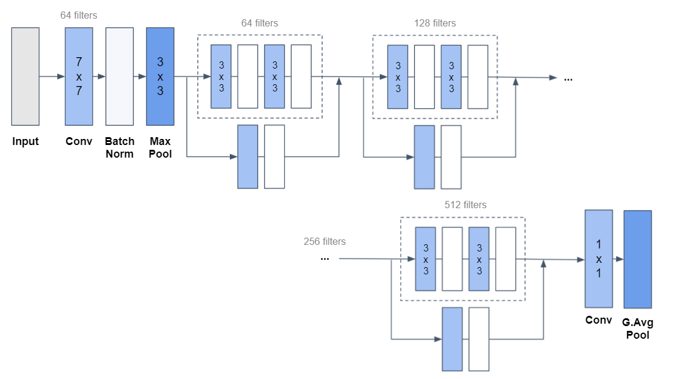
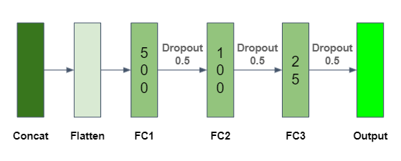
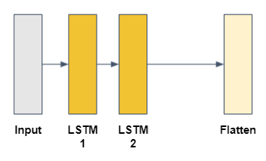
LSTM-CNN model
Model Structure
CNN
Fully-Connected
LSTM

Slide 5
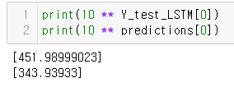
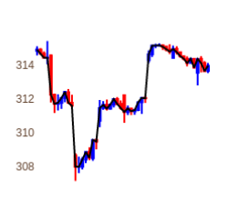
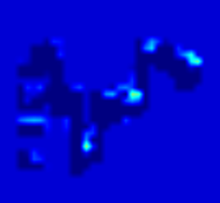
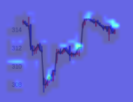
Result
Prediction
Early stop at epoch 26
Val_loss : 0.0105
Result
Heat-Map
Img
Heatmap
Overlayed 7:3

Slide 6
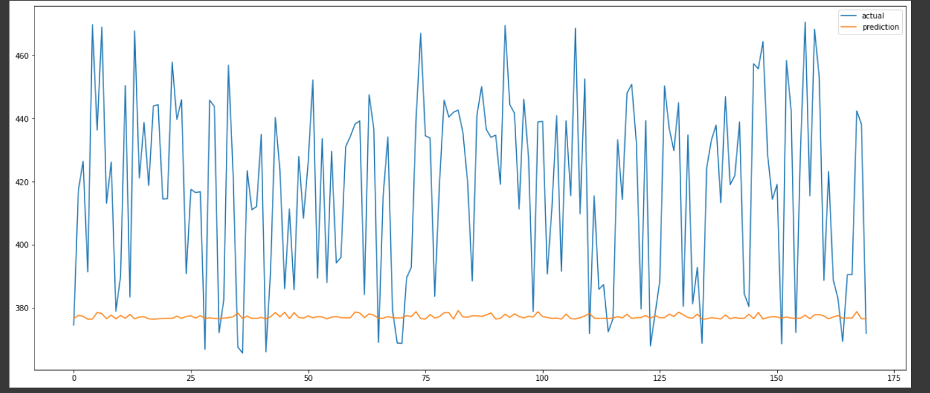
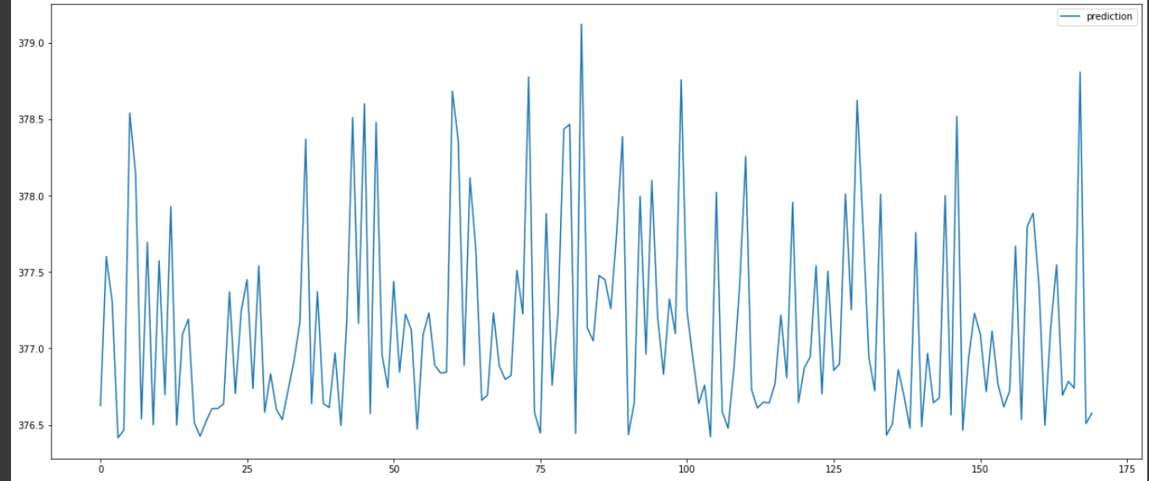
Performance challenge
Plot of Prediction
Real data + Prediction
Only Prediction

Slide 7
References
[1] 핸즈온 머신러닝 2판, 오렐리앙 제롱 저, 박해선 옮김, 한빛미디어, resnet-34
[2] https://github.com/luanft/lstm-cnn-model

